Slide 1
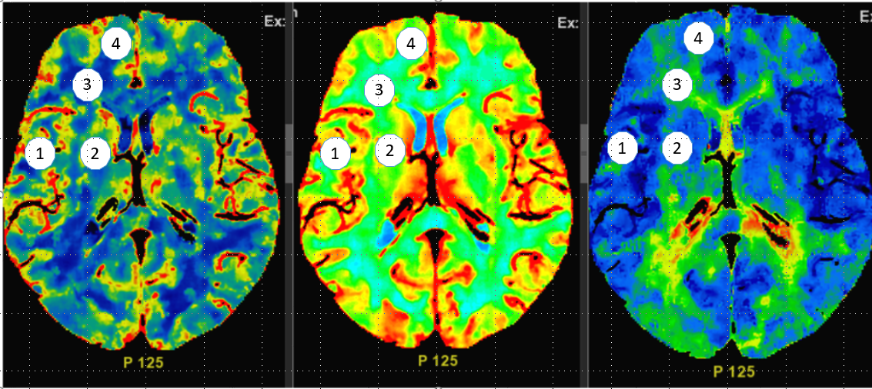
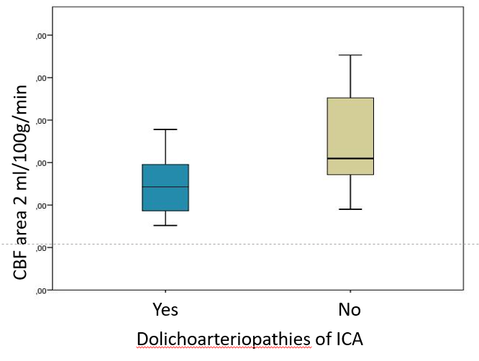
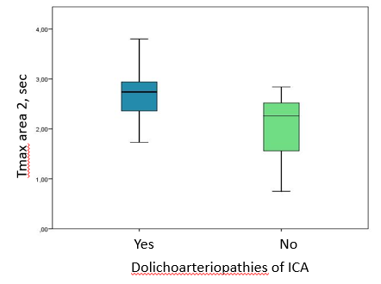
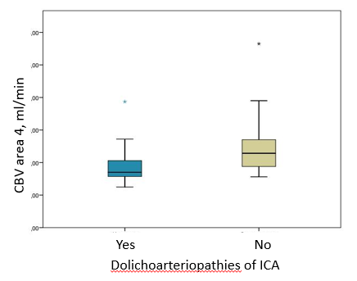
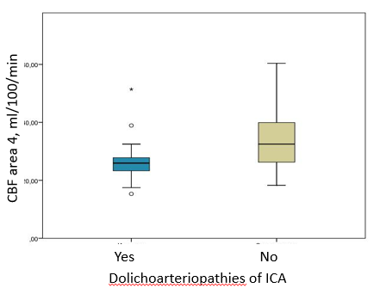
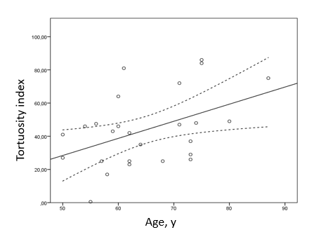
Dolichoarteriopathies of internal carotid arteries and cerebral perfusion
Golovin D. , Rostovtseva T. , Kudryavtsev I. , Berdalin A. , Lelyuk S., Lelyuk V.
Radiology and clinical physiology research center of Federal State Budgetary Institution “Federal center of brain research and neurotechnologies” of the Federal Medical Biological Agency
Background
Results
Dolichoarteriopathies of carotid arteries in some circumstances are considered as sources that have impact on brain perfusion. Existing ultrasound methods are unable to reflect perfusion of brain tissue. The most reliable method of brain perfusion assessment is cerebral perfusion multidetector computed tomography.
A statistically significant decrease (p˂0.05) in the parameters of cerebral perfusion was found within the normal range in the territories of elongated carotid arteries.
We noted a correlation between the length of the elongated carotid arteries and the age of the patients, but did not find a correlation between age and white matter disease (WMD).
A statistically significant decrease in cerebral perfusion indices was recorded in the vascular areas of the anterior cerebral arteries and lenticulostriatal arteries on the side of the dolichoarteriopathies (p <0.0005; Fig.2 A-D).
We also found a correlation between the degree of lengthening (tortuosity index) of the carotid arteries and the age of the patients, as well as the WMD of the brain. The association between the severity of the increase in blood flow velocity, assessed by Doppler studies, and perfusion parameters has not been proven (Fig.3).
We obtained similar results in an earlier pilot study.
Figure 1. CT perfusion assessment area
Methods
MRI (T1, T2, ASL, 3D-TOF) and perfusion CT angiography of the brain were performed in 31 patients with DICA and ischemic stroke of the contralateral hemisphere, as well as 14 patients in the control group with ischemic stroke in the hemisphere without DICA. In all patients, according to the results of duplex scanning of extracranial portions of the brachiocephalic arteries, different types of dolichoarteropathies were identified.
We measured the values of CBF (cerebral blood flow, ml/ 100 g substance / min); CBV (cerebral blood volume, ml/ min) and (Tmax). The area of interest was 1 cm2 (Fig.1)
A
B
Conclusion
C
D
The revealed decrease in the parameters of cerebral perfusion in the vascular areas of the anterior cerebral arteries and lenticulostriatal arteries in patients with dolichoarteriopathies requires further research. There was no correlation between the increases in velocity in the extracranial parts of the internal carotid arteries and the level of perfusion in the anterior circulation.
Figure 2 . Comparison of CBF (A) and Tmax (B) in the area of the lenticulostriatal arteries and CBF (C) and CBV (D) in the ACA area; p <0.0005
Figure 3. Correlation between tortuosity index and age

