Slide 1
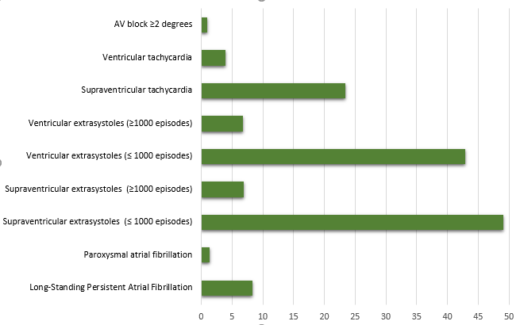
The structure of cardiac arrhythmias in patients with cardioembolic stroke.
Holter ECG monitoring results.
Ivanova N., Golovin D., Berdalin A., Lelyuk S., Lelyuk V.
Radiology and clinical physiology research center of Federal State Budgetary Institution “Federal center of brain research and neurotechnologies” of the Federal Medical Biological Agency
Background
Methods
Results
Cardioembolism is the leading cause of transient ischemic attacks and ischemic stroke. Sources of emboli can be not only walls and valves, but also the formation of blood clots in the cavities when the rhythm is disturbed. Verification of potentially embologic arrhythmias requires the use of long-term ECG monitoring.
In the period from January to August 2021, 956 people with suspected cardioembolic (according to TOAST) mechanism of development of acute focal cerebral ischemia who are undergoing medical rehabilitation in the early recovery period of ischemic stroke underwent 3-channels Holter ECG monitoring.
The duration of the monitoring was at least 24 hours. T
he group of patients consisted of 330 (34.5%) women (64 ± 13 years old, 27-95 years old) and 626 men (60 ± 11 years old, 21-90 years old).
The structure of the variants of cardiac arrhythmias identified by us was as follows:
Long-Standing Persistent Atrial Fibrillation was 8.37% (CI 80 people: 6.69-10.31%);
Paroxysmal atrial fibrillation 1.36% (13 people, CI: 0.73-2.31%);
Supraventricular extrasystoles (≤1000 episodes) - 49.06% (469 people, CI: 45.84-52.28%);
Supraventricular extrasystoles (≥1000 episodes) - 6.9% (66 CI humans: 5.38-8.70%);
Ventricular extrasystoles (≤ 1000 episodes) - 42.89% (CI 410 people: 39.72-46.09%);
Ventricular extrasystoles (≥1000 episodes) - 6.8% (65 people, CI: 5.29-8.58%);
Supraventricular tachycardia 23.43% (224 people, CI: 20.78-26.25%);
Ventricular tachycardia 3.97% (38 people, CI: 2.83-5.42%);
AV block ≥2 degrees 0.94% (CI 9: 0.43-1.78%).
Conclusion
As a result of the analysis of 24-hour Holter ECG data, the most frequent variant of rhythm disturbance in the patients examined by us, who have a potentially high risk, the mechanism of ischemic stroke of the cardioembolic type is supraventricular extrasystole (49.06%). The rate of the most embologic atrial fibrillation was 9.73%.
Figure 1. frequency of various arrhythmias

